Slide 1
Convert casual riders to annual members
By: Amin SHERZAD
Last updated: April 3, 2022

Slide 2
Objective
Identifying trends in using bike for annual members and casual riders, to help convert casual riders to annual members.
Notes:
Note: Let the audience to know that subscriber and member is the same and casual and customer is also same.

Slide 3
Data overview
The dataset is only from 2018 divided by quarter, it’s publicly available online.
The dataset is limited to the United States, Chicago city.
Notes:
In next slide, we will talk about some manipulation in our data

Slide 4
Data manipulation:
Variables added: quarter, ride_length, day_of_week. These are needed for analysis phase.
Outliers are removed
Alignment: some symbols removed from values
Notes:
There was some comma which were used to separate numbers in ride length columns, during calculation it was running into error, so I just removed them to avoid error. Also outliers are removed as per quarters.

Slide 5
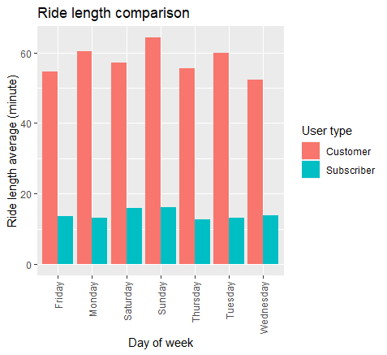
Ride length by weekday
No relation between casual and member riders
Members are taking short rides but more rides all weekdays
Casual riders take long rides but fewer rides all weekdays
Notes:
This graph shows the distance average which each user type took by weekday. In next slide, we will disaggregate this graph by quarter to give us detailed view.

Slide 6
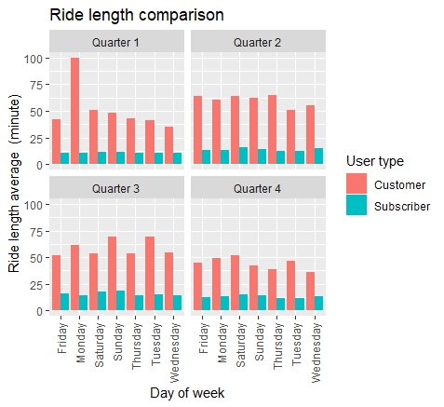
Ride length by quarter
Disaggregation result at quarter level gives us detailed result, but still no correlation between those two ride types.
Notes:
This graph shows the distance average which each user type took by weekday at quarter level. Next, will walk you through a trend analysis between ride frequency and length.

Slide 7
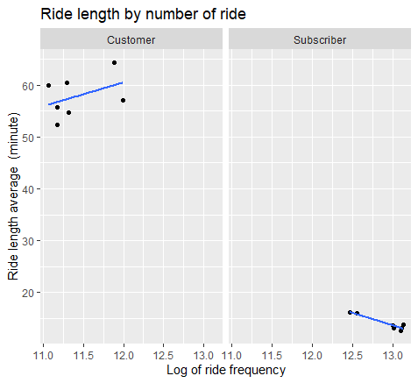
Trend in ride duration and frequency
The data shows a relationship between number of rides and ride length for each user type separately.
Annual members: when the number of rides grows, the length of ride comes down
Casual riders: when number of rides grows, the ride length will also grow
Notes:
Based on the analysis result, it looks there is no relationship between customers and subscribers in general. But, overall subscribers mostly take the rides for shorter distances but many rides. Despite that, customers take the rides for longer distances but few rides. This is consistent for overall analysis and also disaggregated by quarter.
Taking the log of ride frequency, because the original numbers are long and appearing with scientific symbols.

Slide 8
Conclusion
No relationship between members and casual riders in using bikes
Annual members are using bike for short length and more times in all weekdays
Casual riders are using bike for long length and fewer times in all days
Finally, we can encourage casual riders with different membership benefits considering their use of bikes, while we keep the previous membership for our existing members.

Slide 9
Thank you

